Slide 1
Predicting Flight Prices
Data Science Final Project
By Bar Sade
http://www.free-powerpoint-templates-design.com

Slide 2
TimeLine
Crawling and gathering all the data
Eda and Visualization
Conclusions
First Step
Third Step
Fifth Step
What is the predicting question?
Cleaning all the data gathered
Machine Learning
Second Step
Fourth Step
Sixth Step

Slide 3
What is the predicting question?

Slide 4
Why did I choose predicting Flight Prices?
I have always been a fan of flights.
I used to fly a lot before Covid-19.
Usually, I am the one purchasing tickets for my entire family.
I love exploring the flight prices for each flight ticket purchasing.
I wanted to learn more of how it works, how the prices changes with every criteria chosen and how it is affecting our decisions to purchase flight tickets.
WWW.KAYAK.COM

Slide 5
Start Crawling

Slide 6

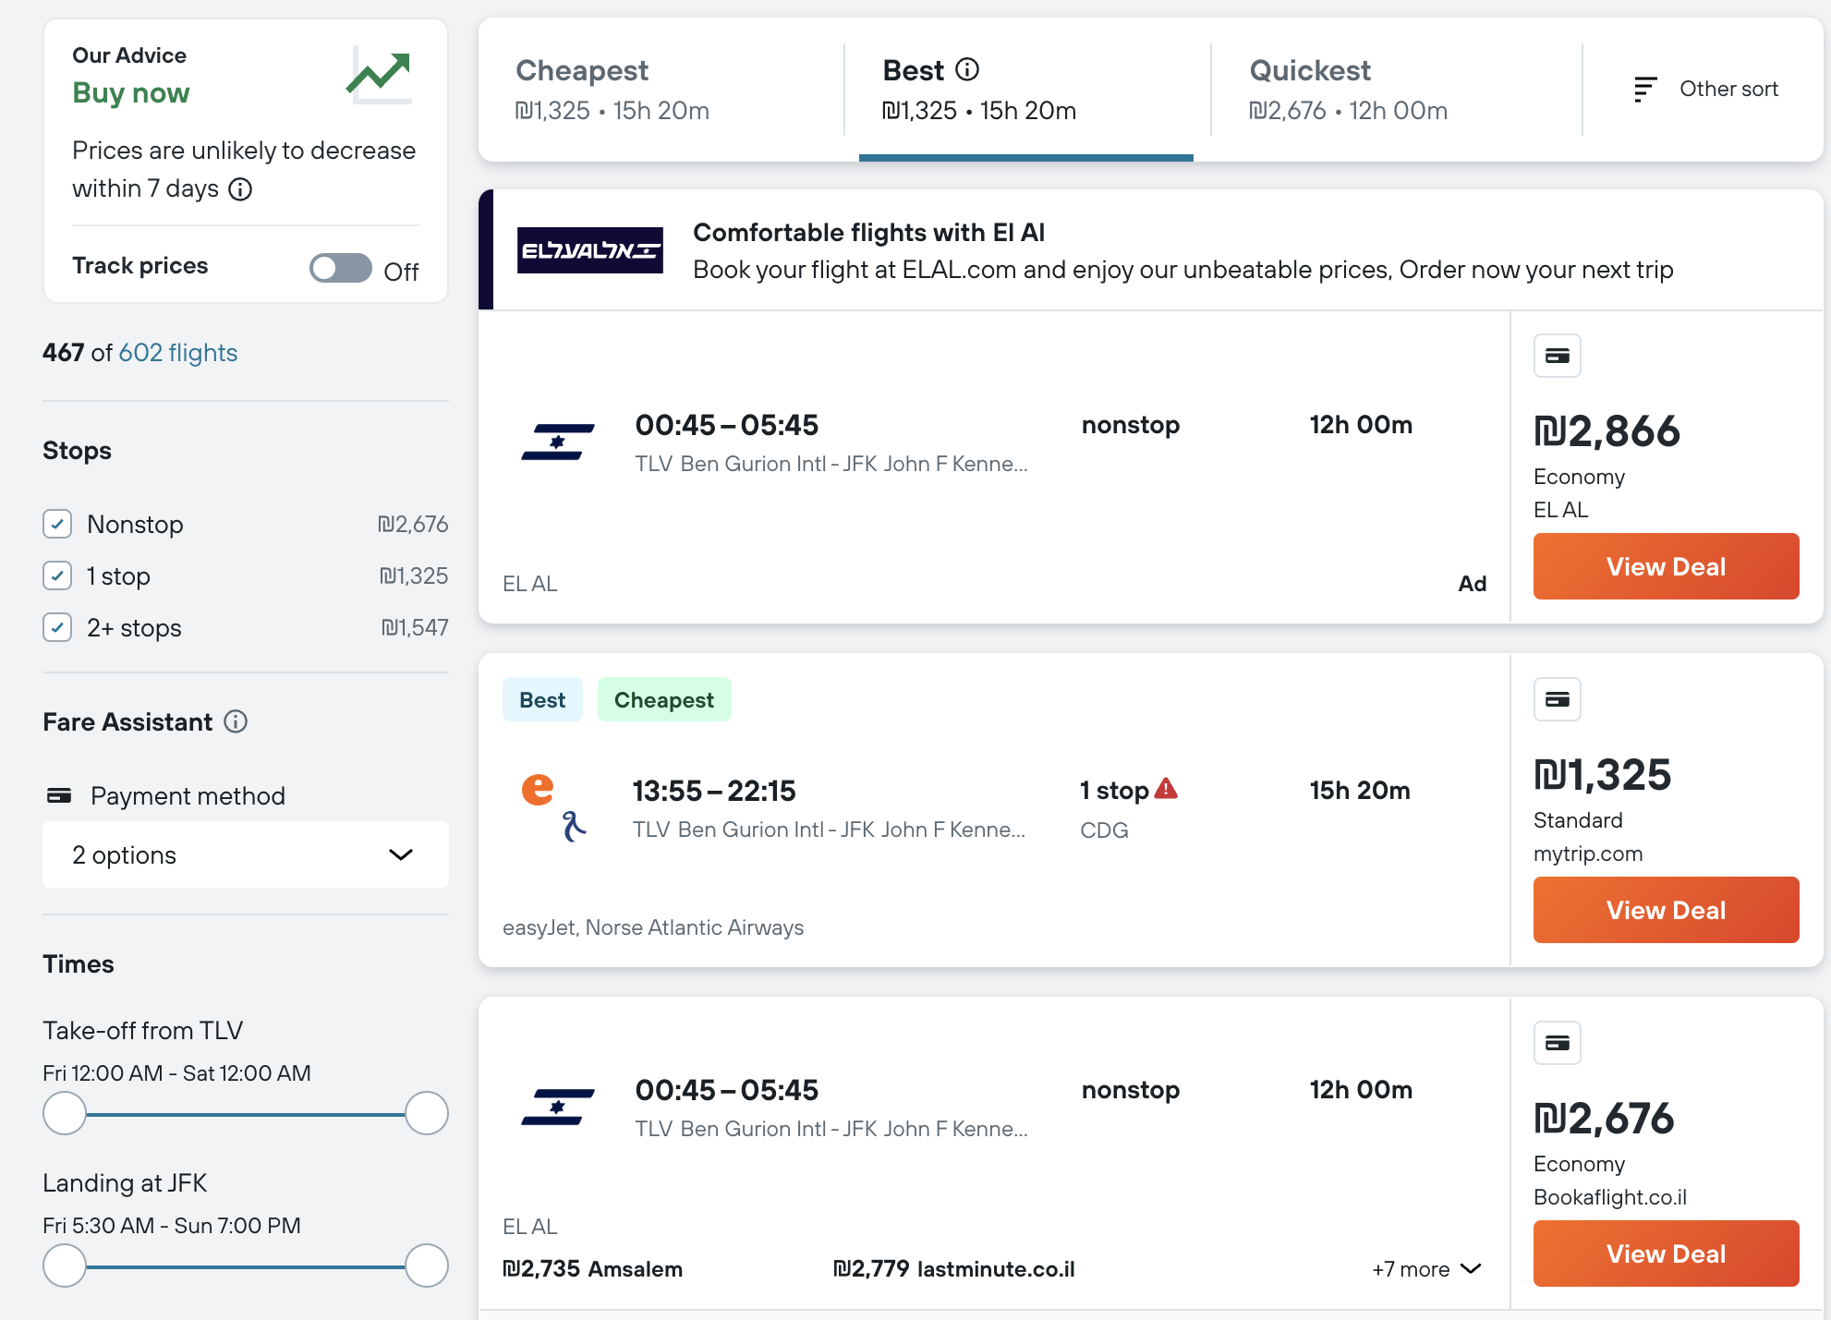
Crawling
Source: https://www.il.kayak.com
I used ChatGPT to extract every link in every day in month of December from TLV to JFK.
In every day, there are many results, I used a function to scroll down the page and click load more results to grab all the data in each page.
I used Selenium to scrape the data.
Using Selenium provided me with a more robust solution to handle the dynamic web elements and interactions required for data extraction. It allowed me to automate the process of data retrieval, ensuring I could access the desired information accurately and efficiently

Slide 7
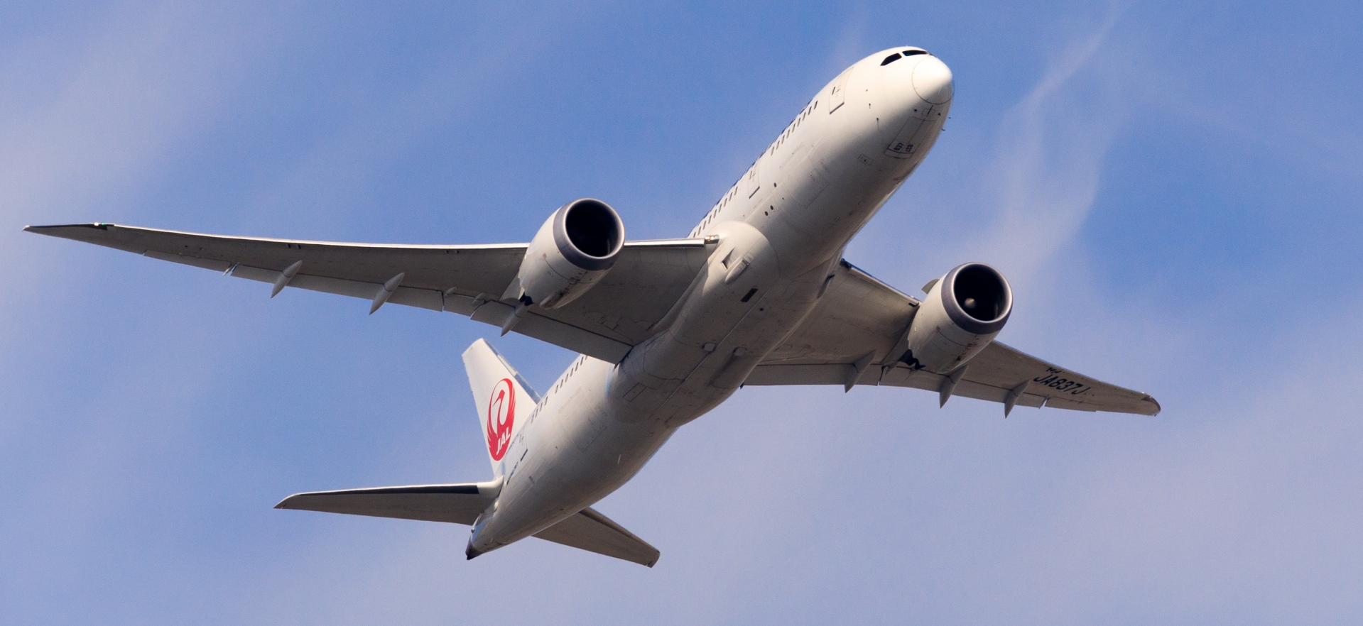
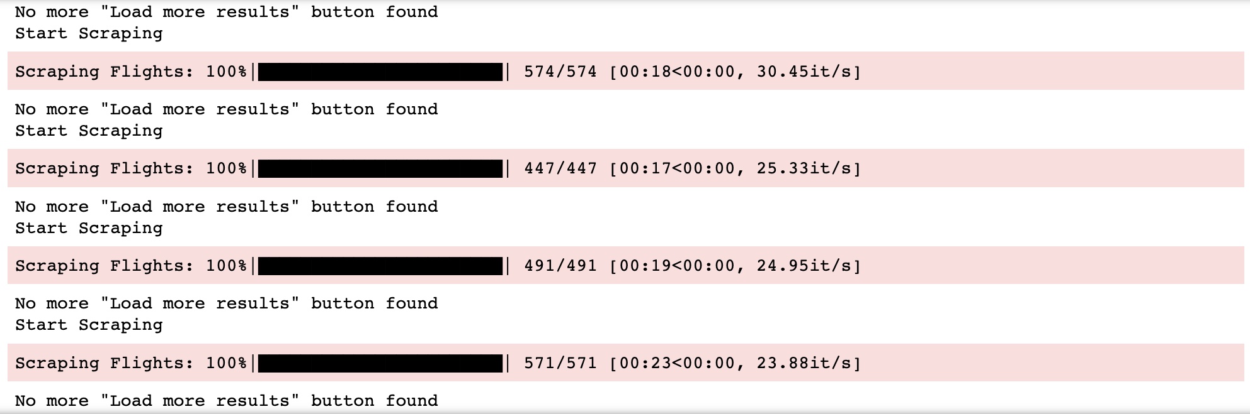
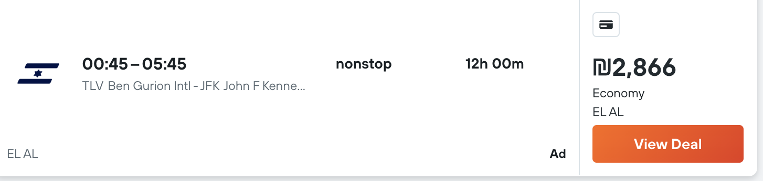
Flight Example
Here we can see the departure hour, arrival hour, duration, airline, number of stops, flight type, price, departure airport and destination airport.
The same data we see for each date in December.

Slide 8
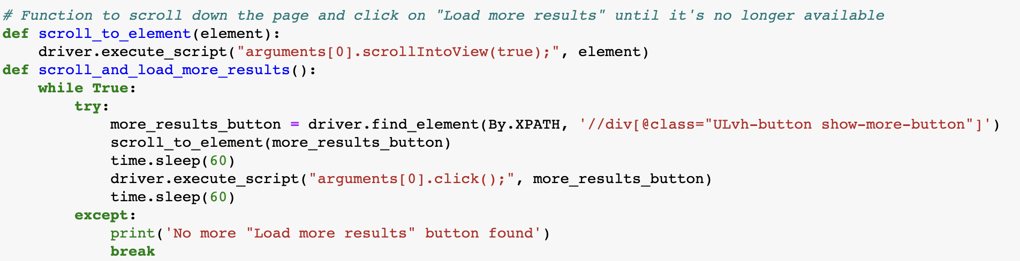
The Crawling Process - Functions
I began with two fonctions:
Scroll_down_to_element which uses selenium to scroll down the page.
The other function scroll_and_load_more_results uses selelnium also to scroll down the page and click on
the ‘show more results’ button until the button is no longer available on the page.

Slide 9
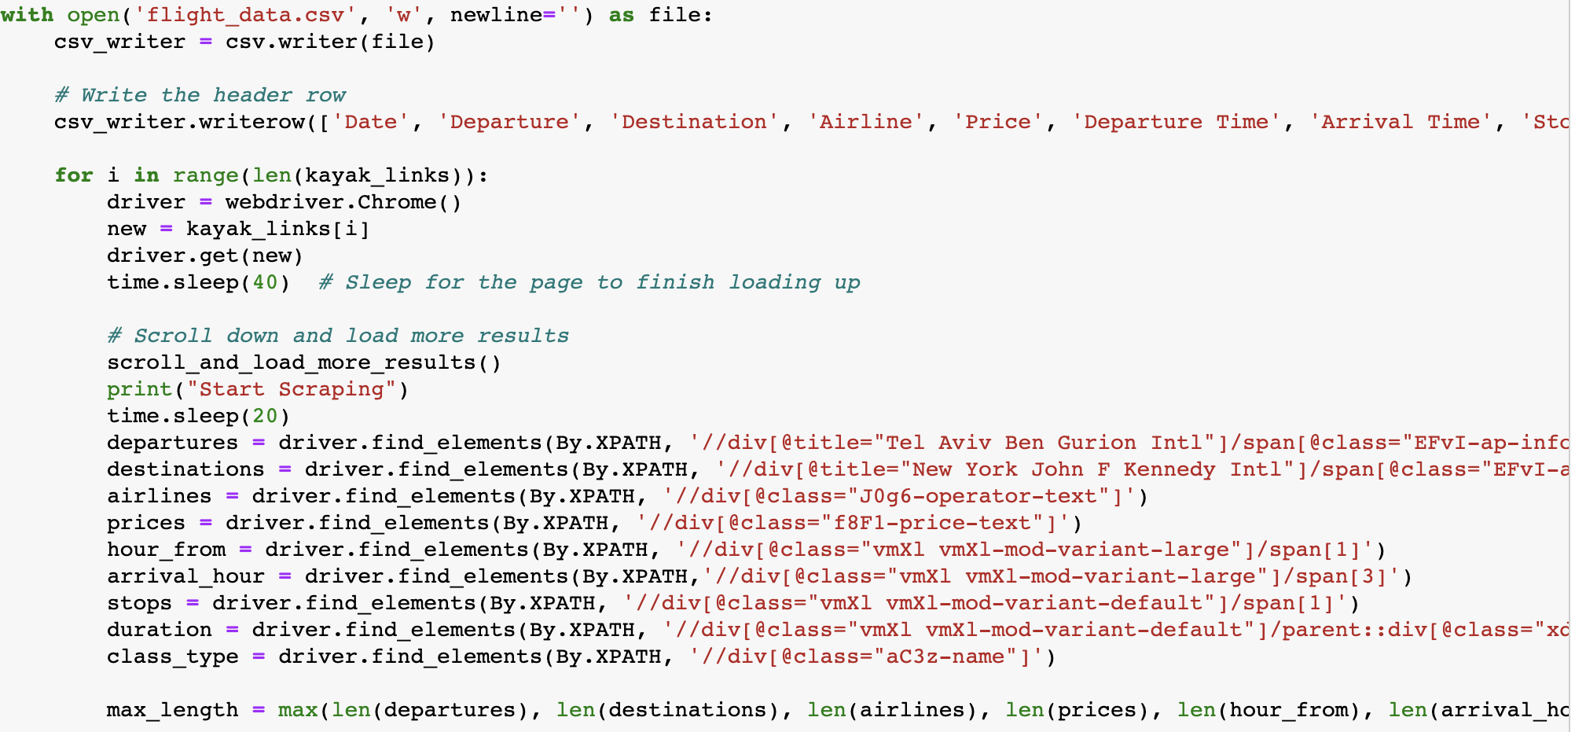
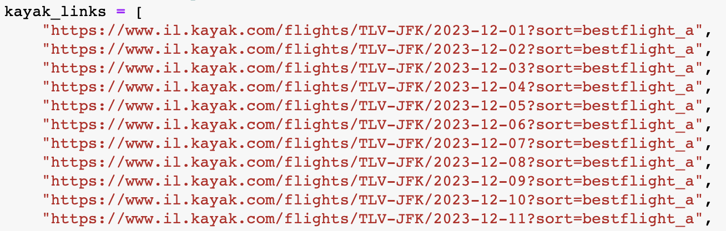
The Crawling Process - Code
To begin collecting data, I opened csv file in writing mode to start writing in it the data collected.
I began with a for loop that runs on every link in the list (I asked chatGPT to give me all the links of the days in December)
I used driver.get(new) to open each link to scrape data from.
After the page opens, I began with calling the function scroll_and_load_more_results to start scrolling down and click on load more results button until its no longer available.
When it finishes, its time to start scraping. I used xPaths to get access to the data I wanted using inspection mode for each column.

Slide 10
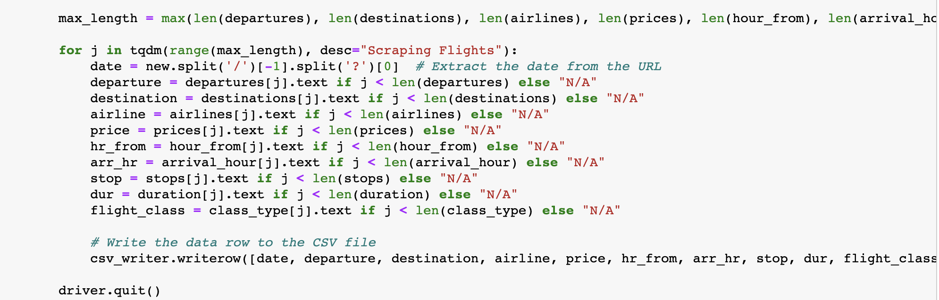
The Crawling Process - Code
The max_length is done to determine the number of iterations needed in the subsequent loop.
The loop iterates max_length times and extracts flight information from each list (departures, destinations, etc.) to their respective variables (departure, destination, etc.), using index j to access the elements. If the index is out of range for a particular list, it assigns "N/A" to the variable instead.
At the end, it writes the extracted flight data as a row to a CSV file.

Slide 11

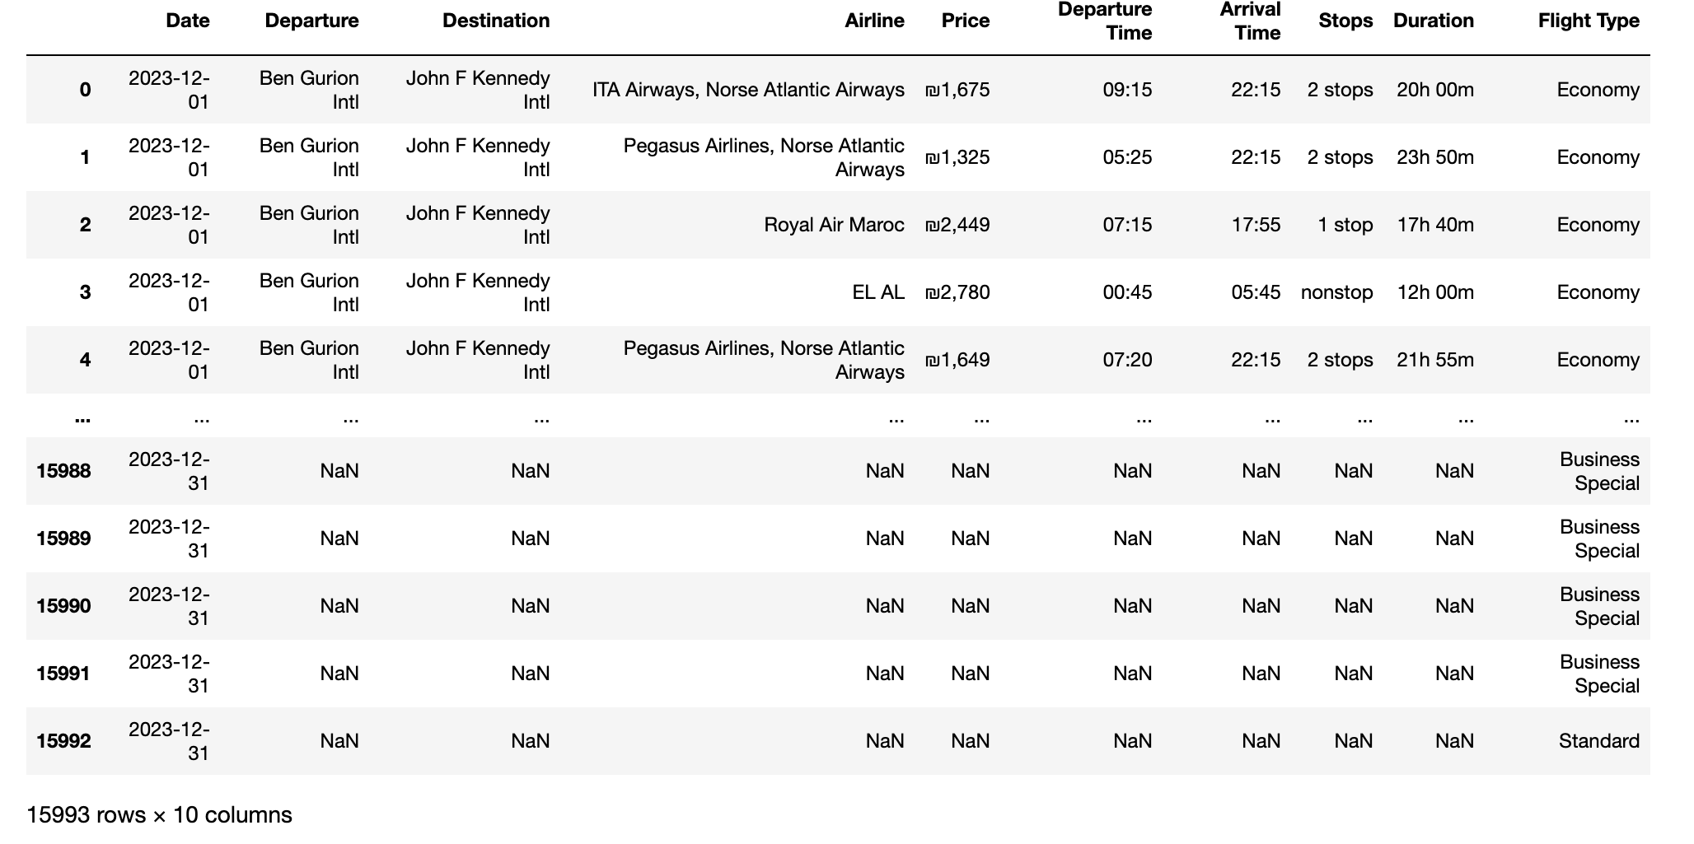
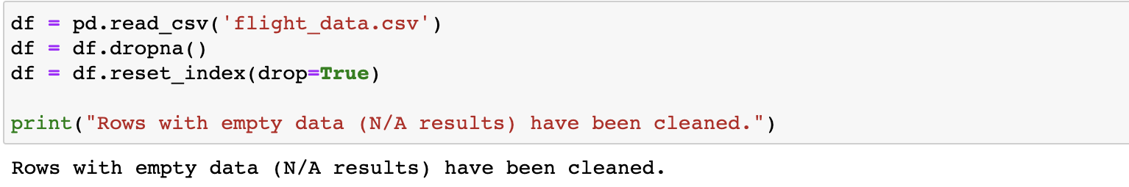
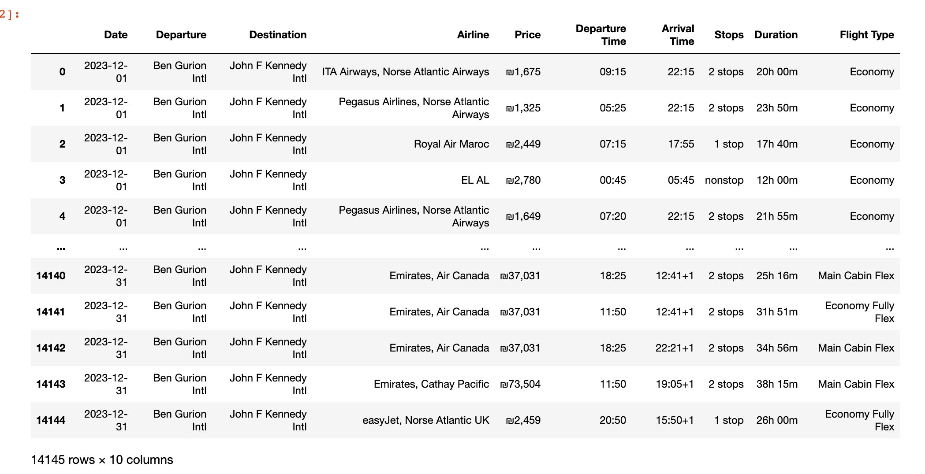
Before Cleaning
Cleaning Data
I had some N/A results in the scraped data, I used df.dropna to clean it up.
After cleaning it up, we can see there are 14145 rows and 10 columns when before cleaning we had 15993 rows and 10 columns.
After Cleaning

Slide 12
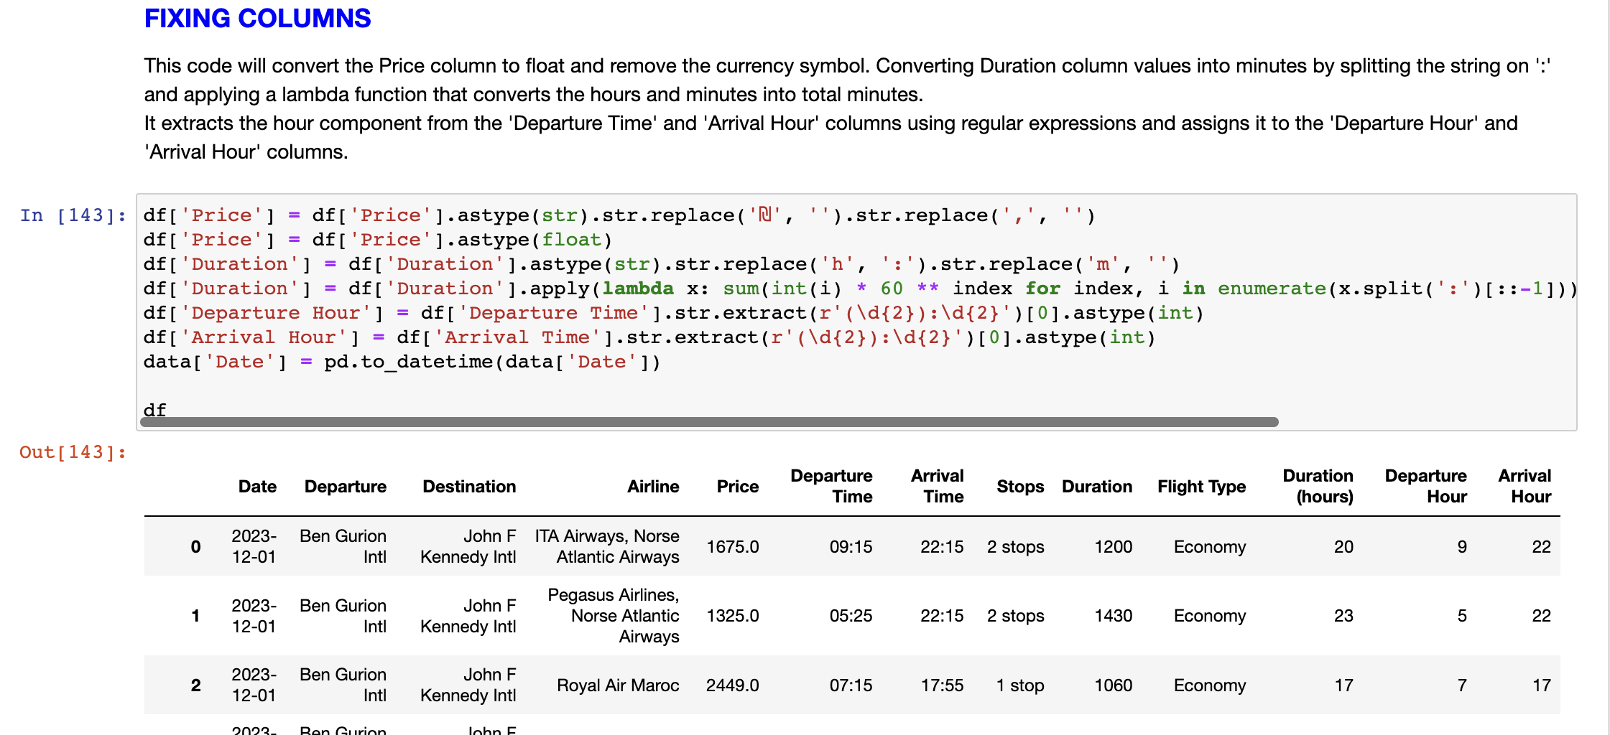
Fixing Data
Some of the columns needed to be converted such as: price column to float and remove the currency symbol, Duration column values into minutes instead of h:m, extracts into new columns the hour component from Departure Time and Arrival Time.

Slide 13
EDA & VISUALIZATION

Slide 14

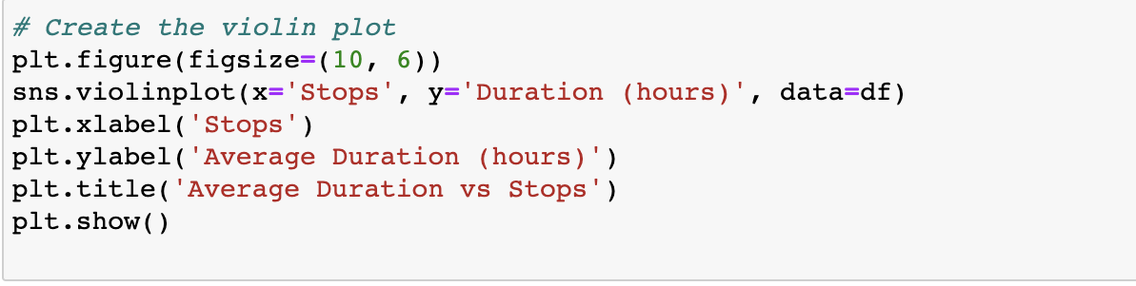
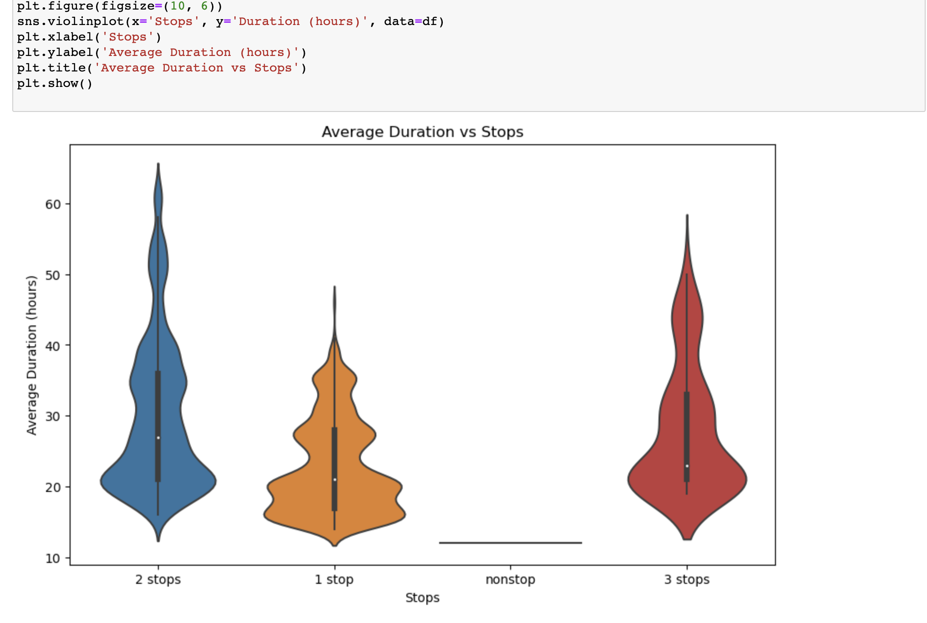
Using a Violin Chart to check the relationship between Average Duration to Stops in each flight

Slide 15
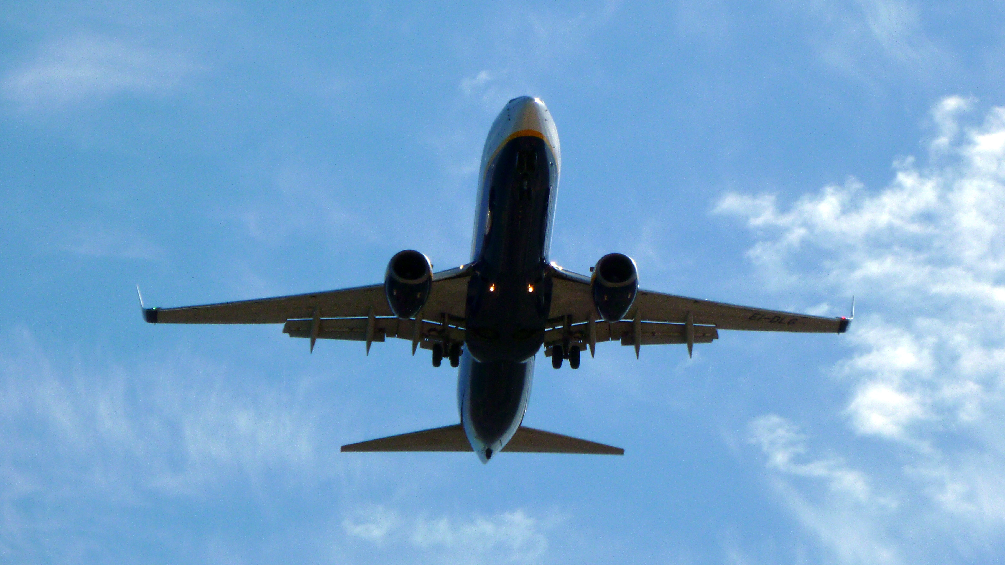
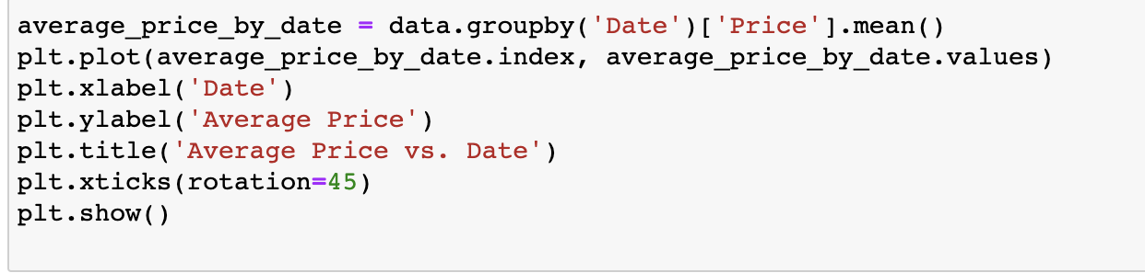
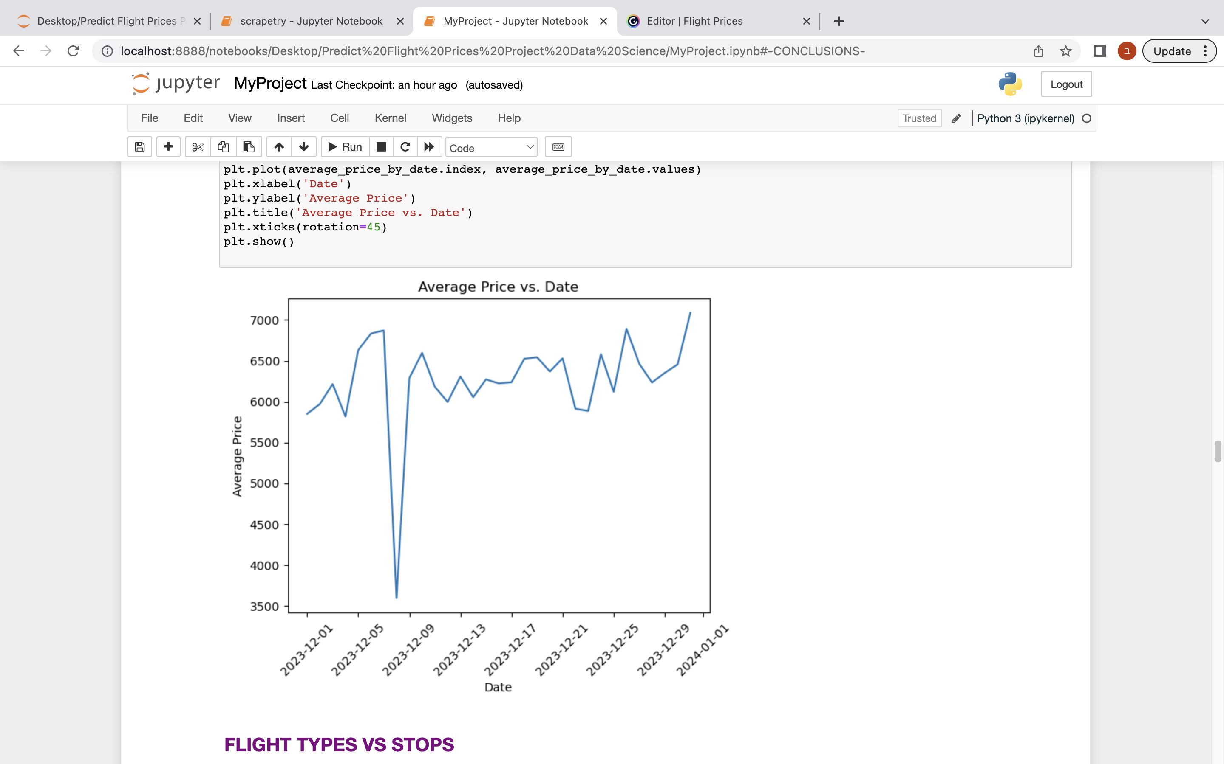
Using a Line Plot to check the relationship between Average Price to Date
This Photo by Unknown Author is licensed under CC BY-SA

Slide 16

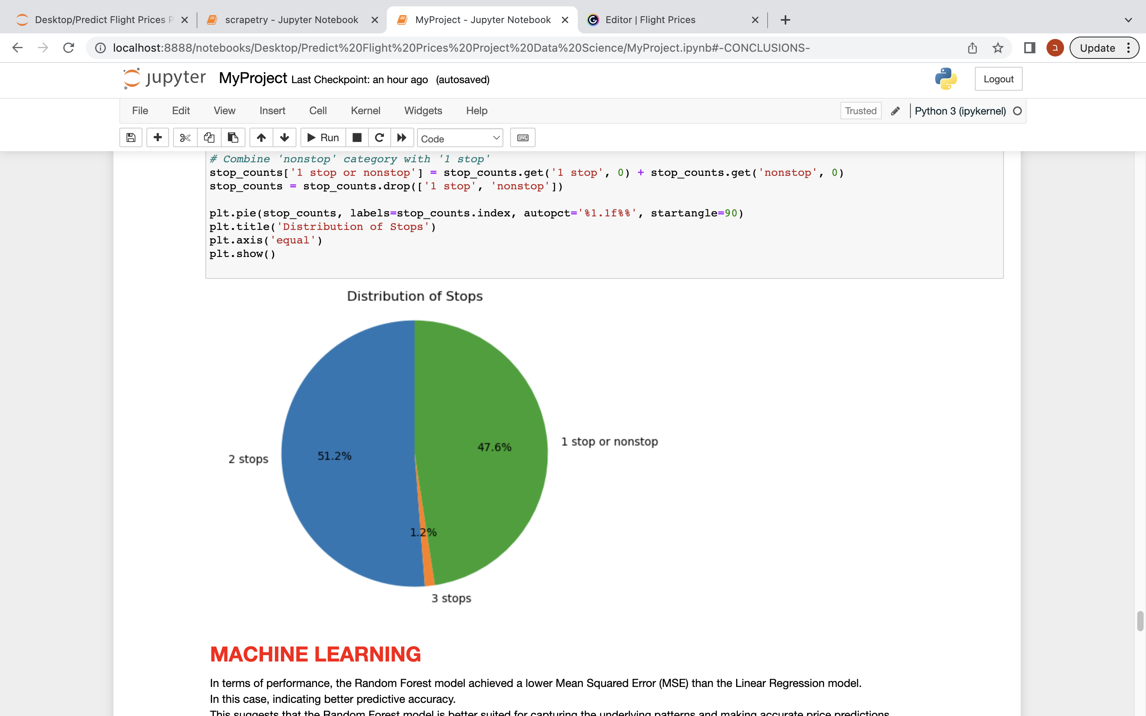
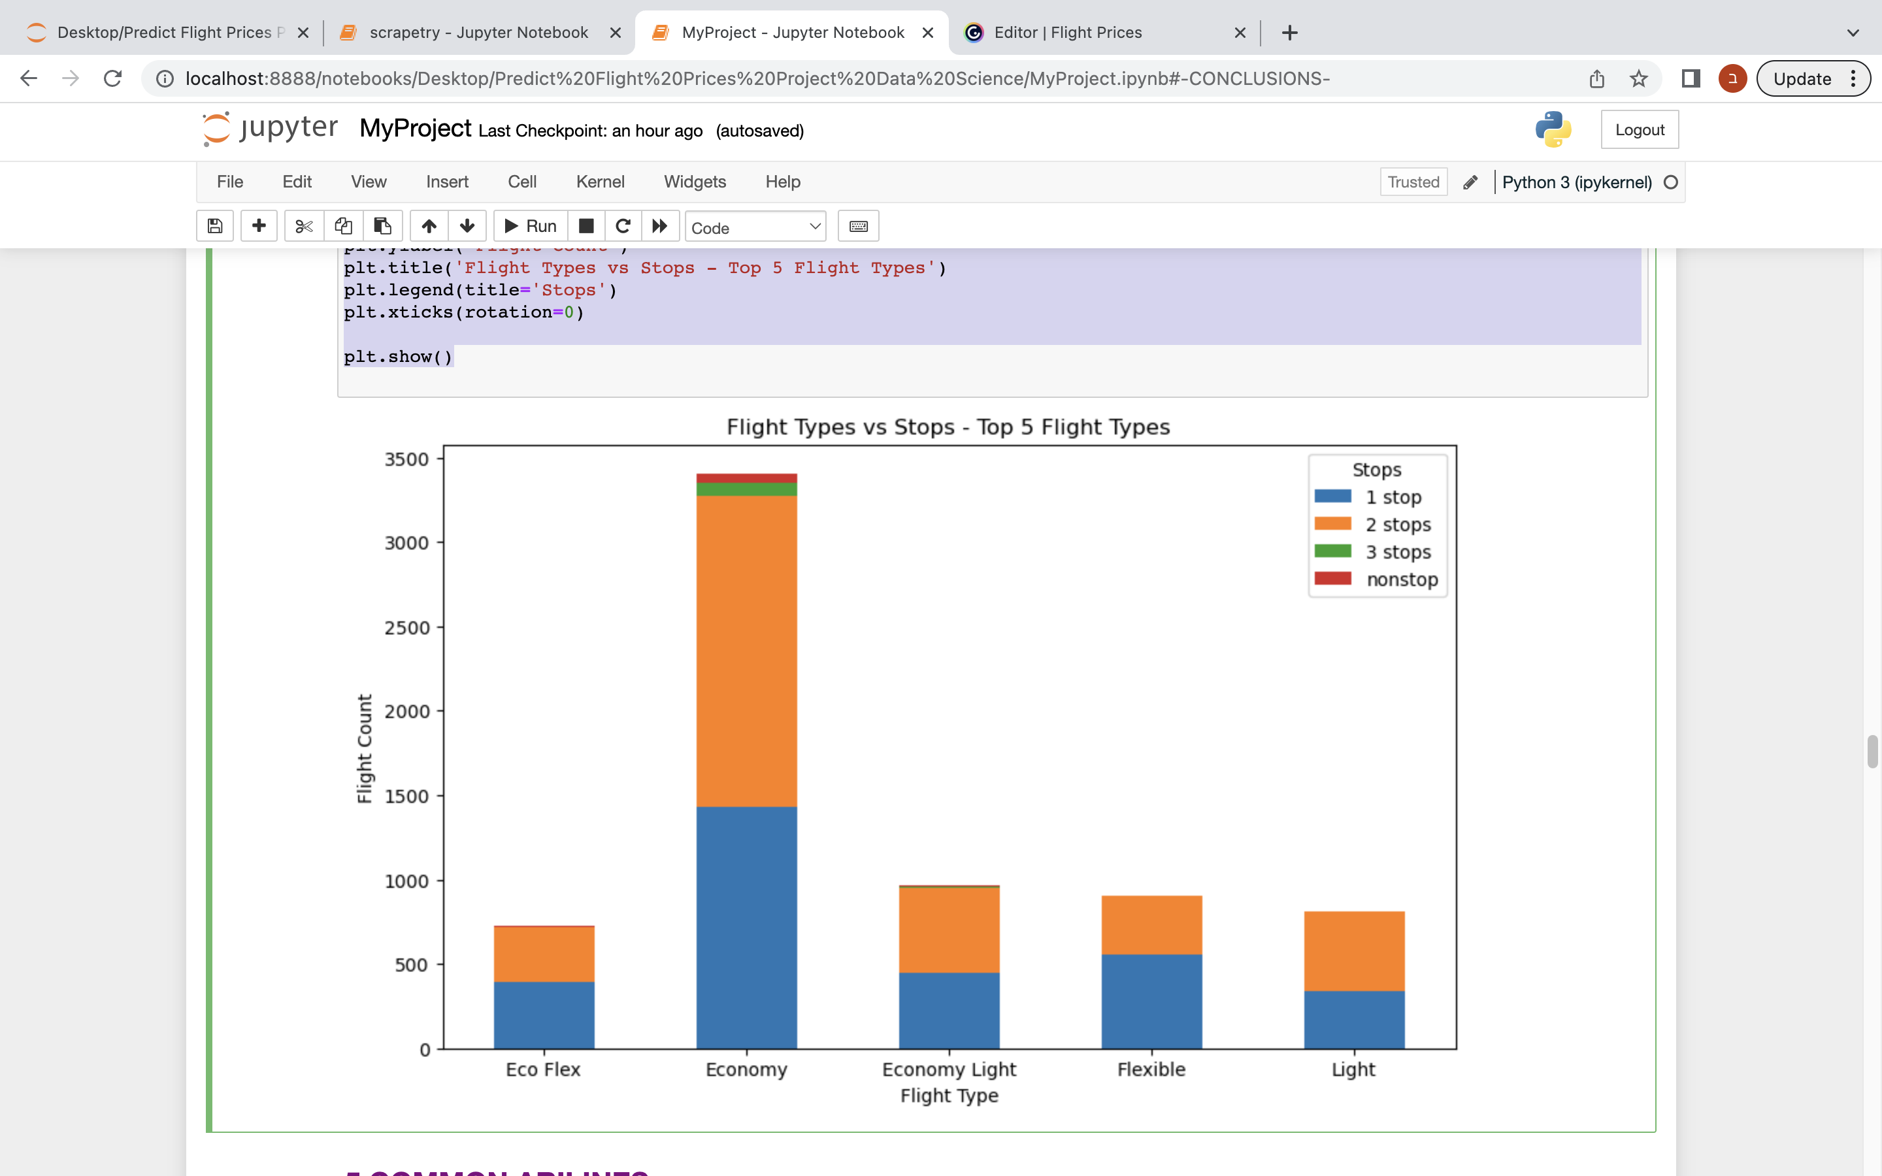
Using a Stacked Bar Chart to check the relationship between Flight Type and Stops and the distribution of stops

Slide 17

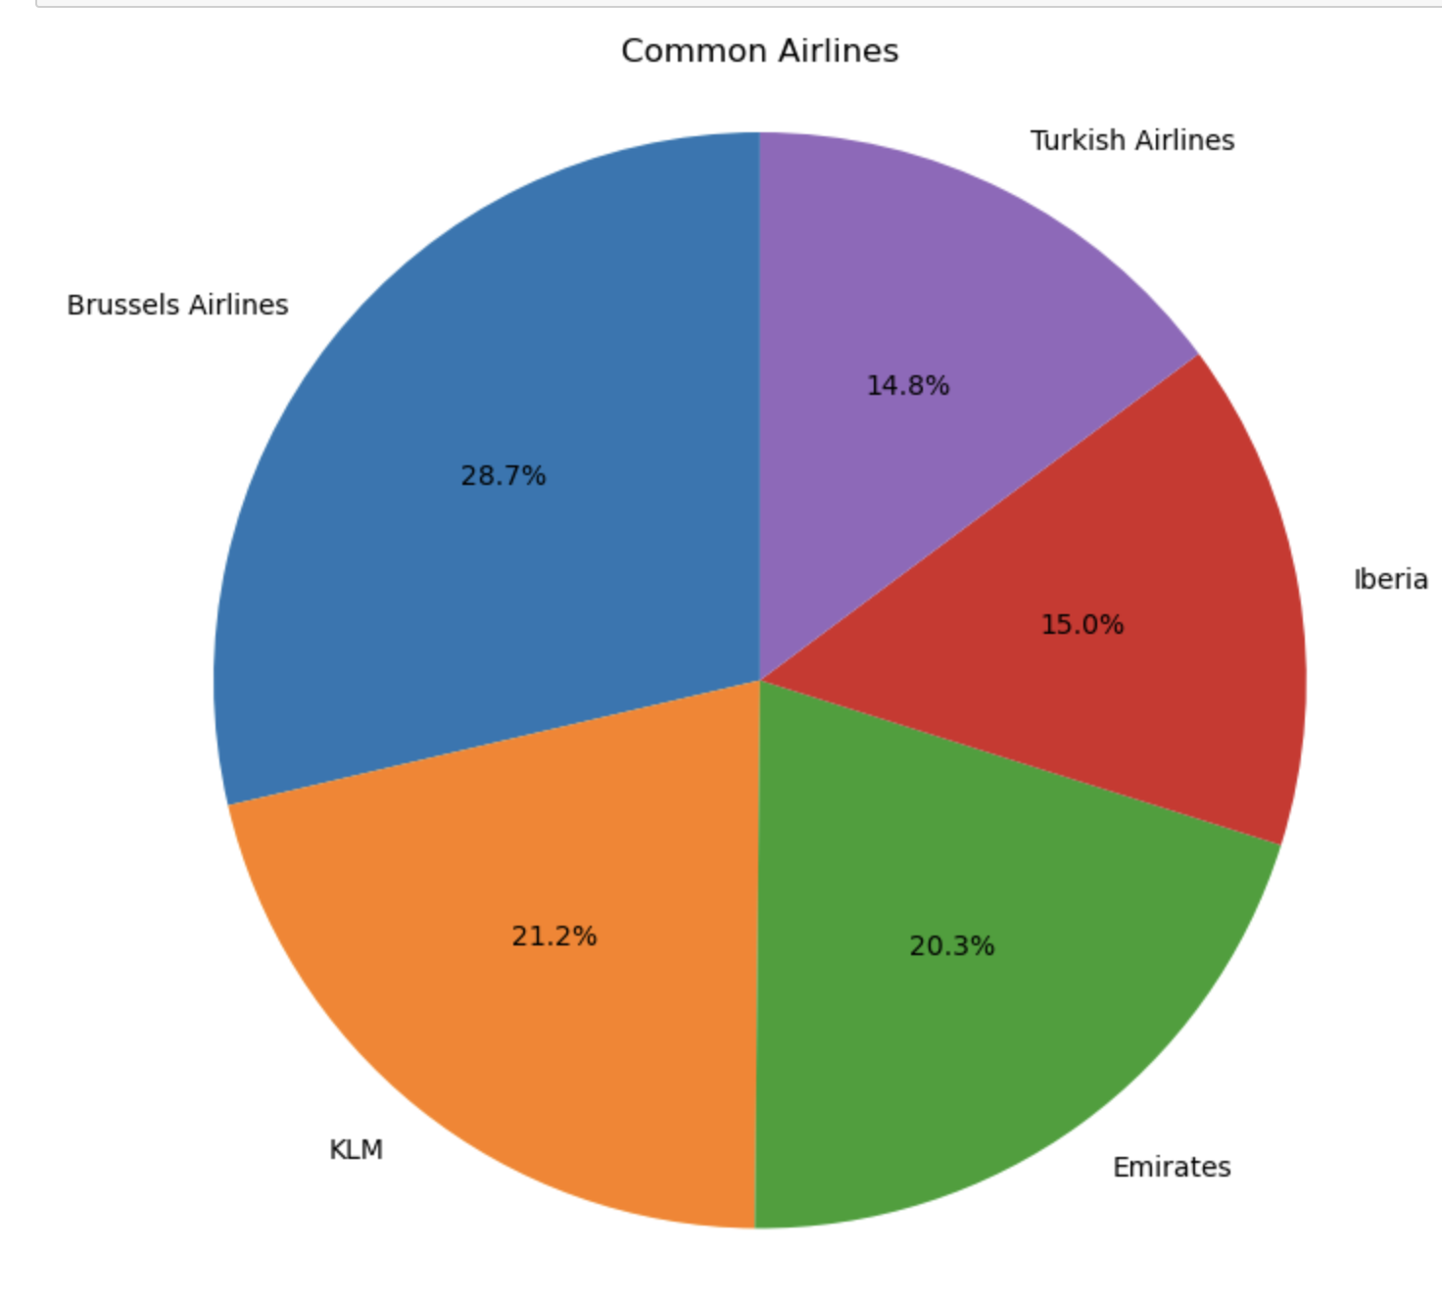
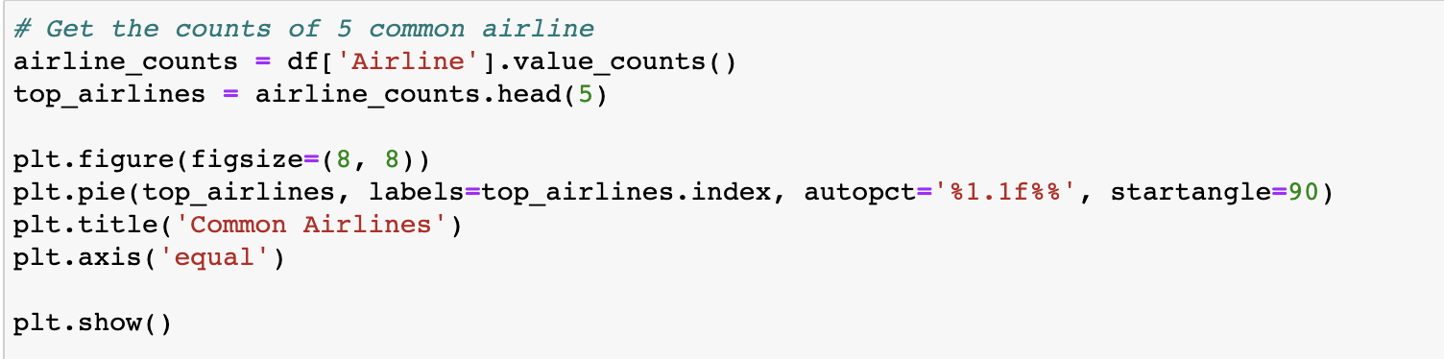
Using a Pie Chart to see the 5 common Airlines

Slide 18

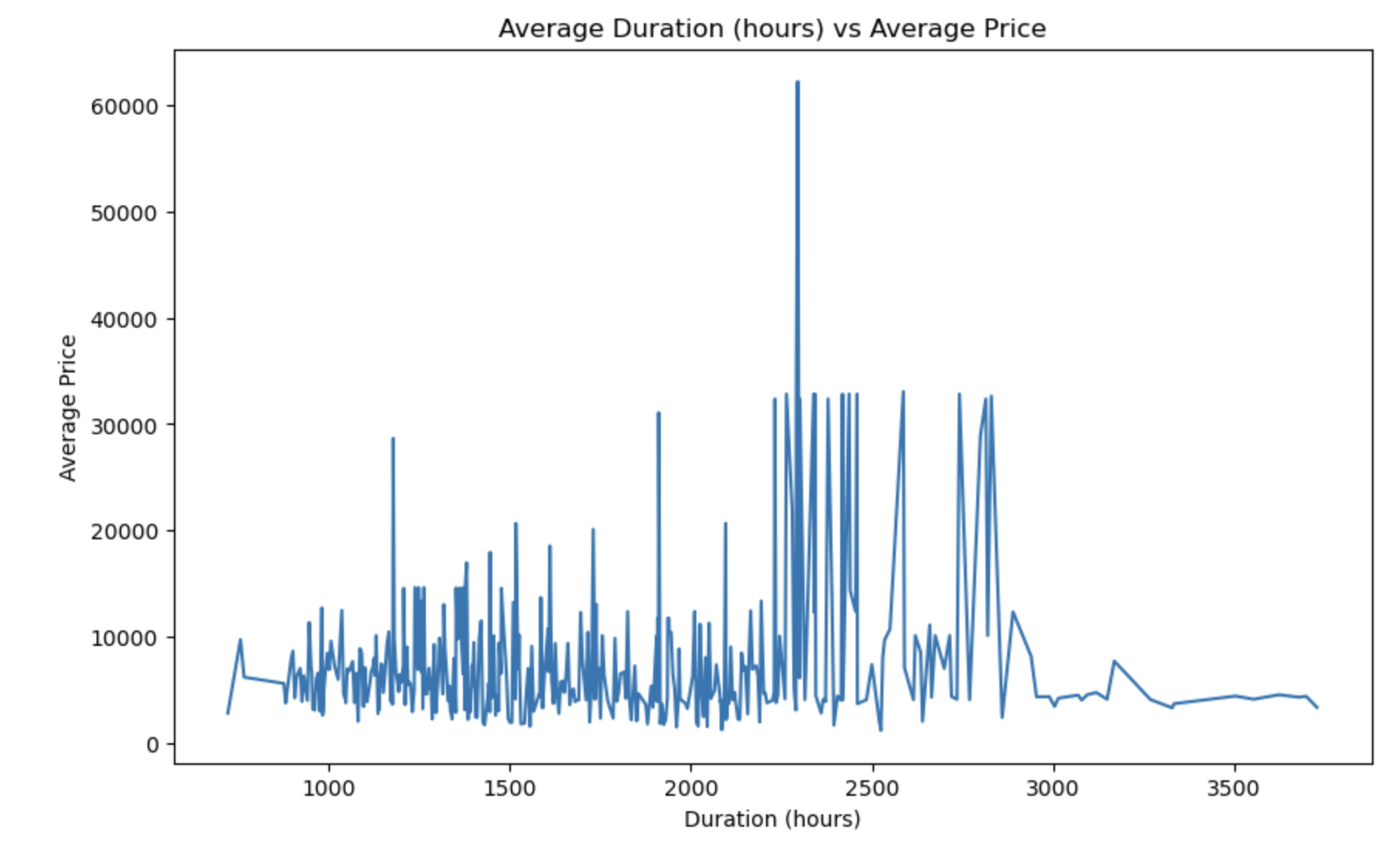

Using a Line Chart to check the relationship between Average Duration and Average Price

Slide 19

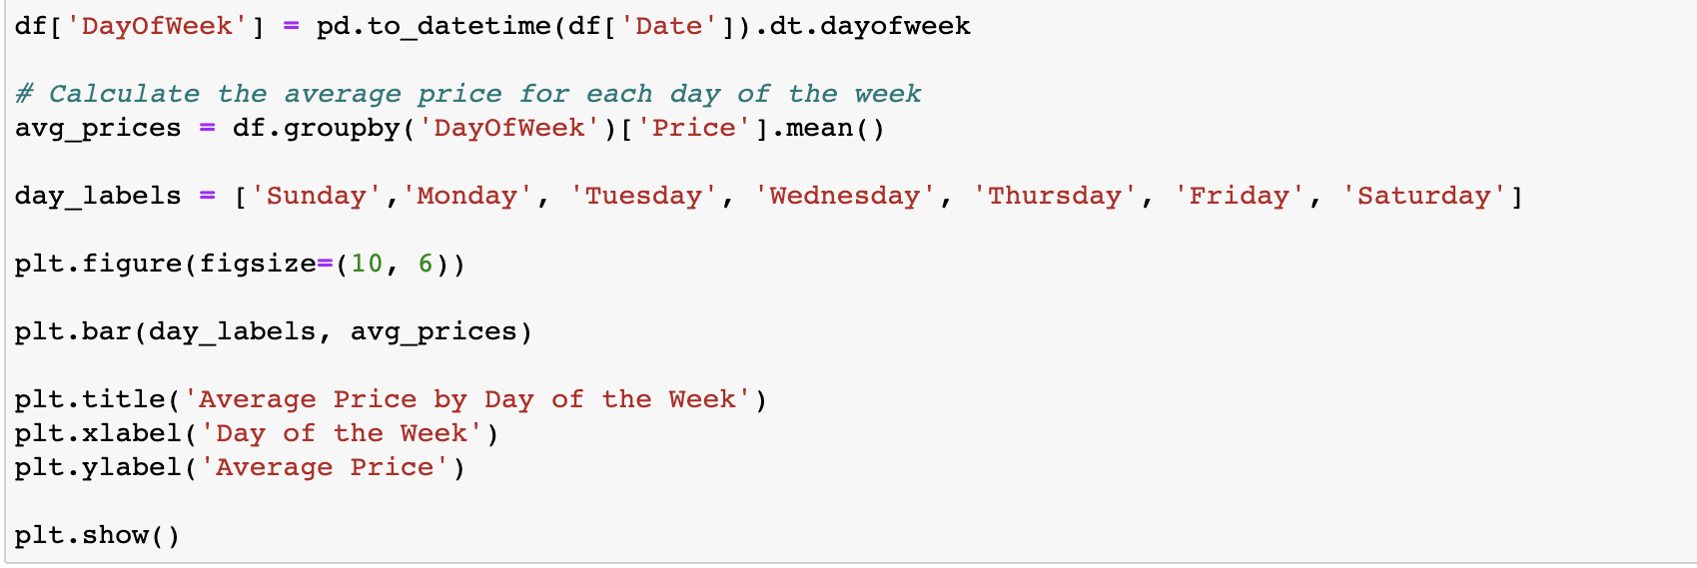
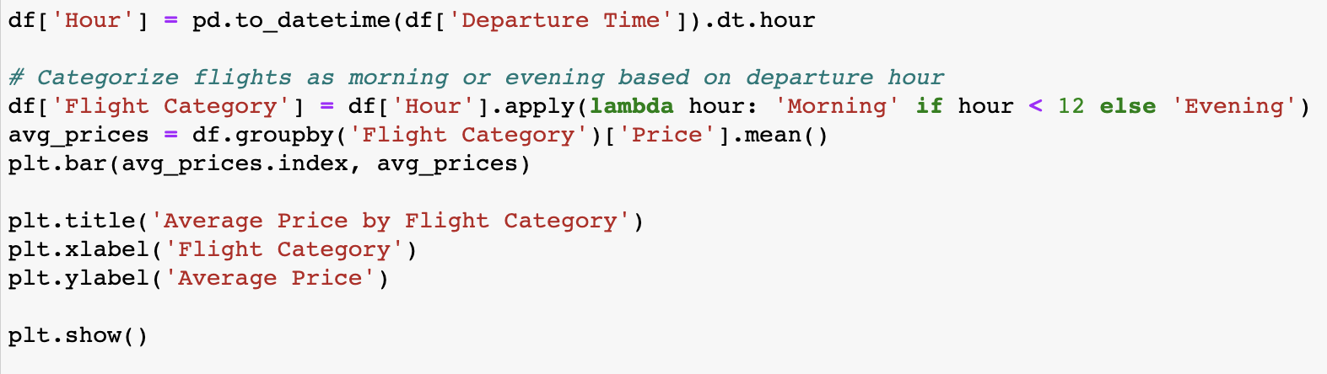
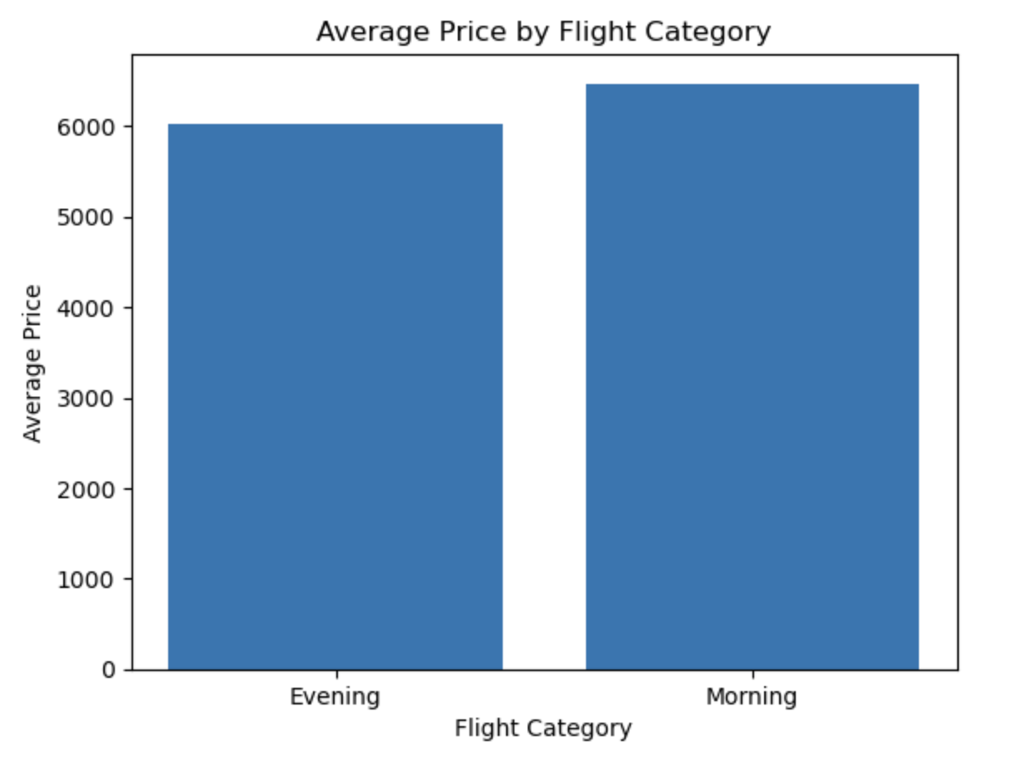
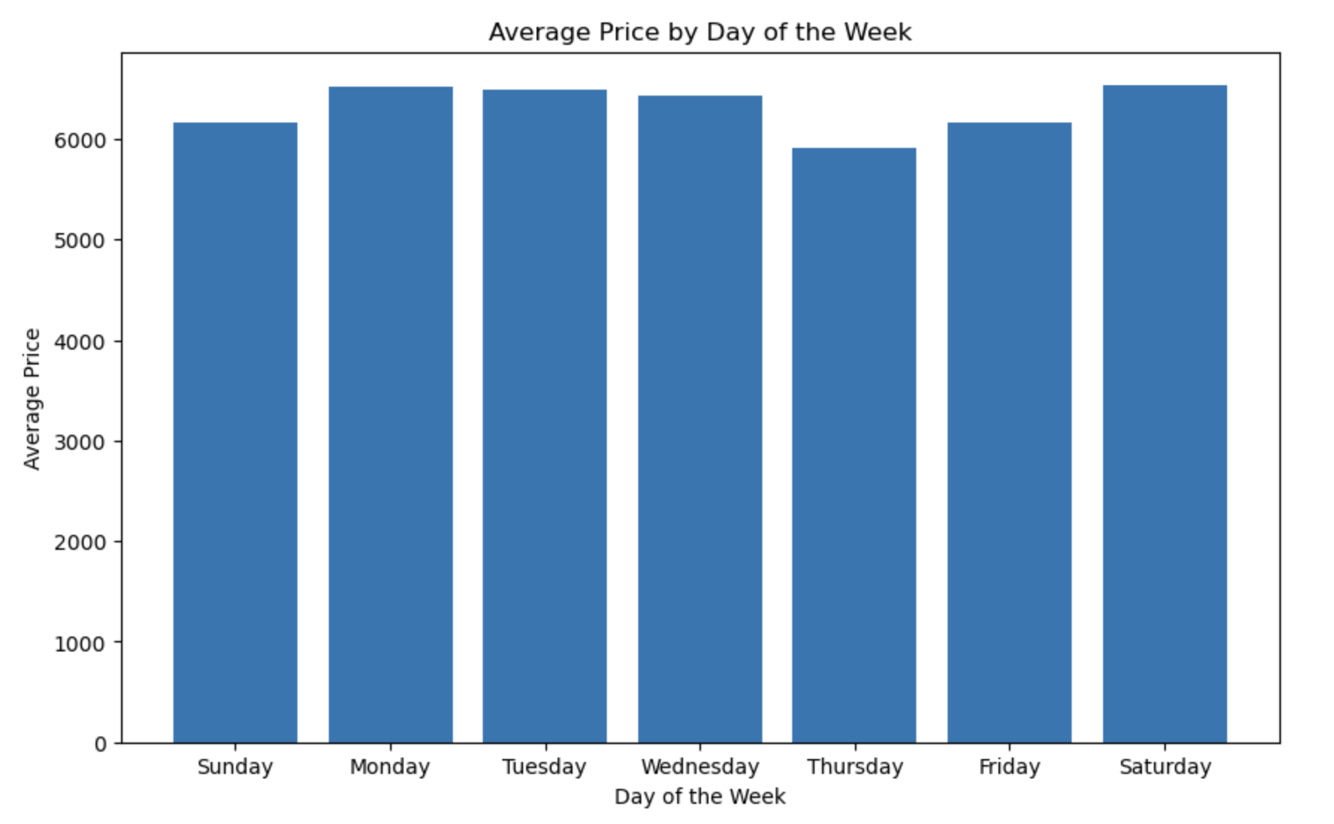
Using a Bar Chart to check the relationship between Price and flight category (day of the week, morning or evening flight)

Slide 20
Machine Learning

Slide 21

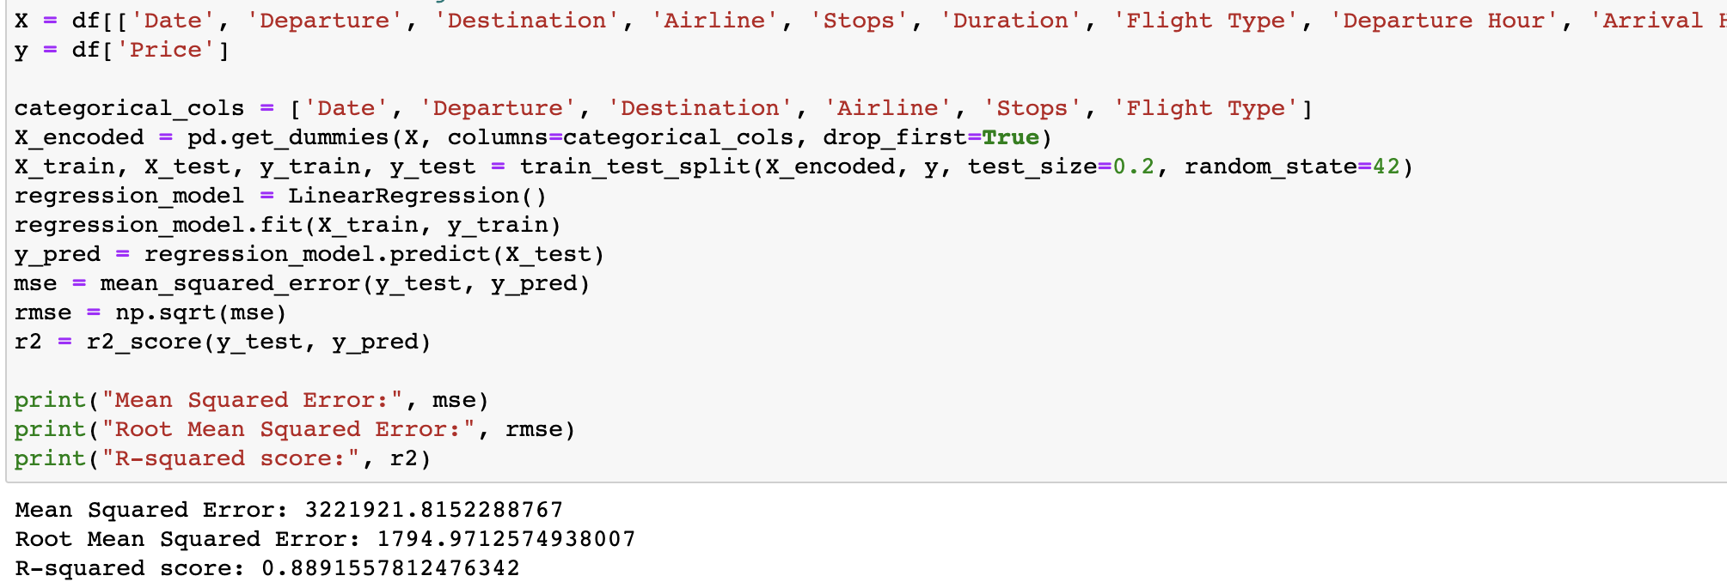
I used several Machine Learning models to determine what is the most efficient model to predict flight prices
The first one I used is Linear Regression model, it is a statistical modeling technique used to understand and analyze the relationship between a dependent variable and one or more independent variables.
I checked between Price (as y) to each other column I have (as x), the results were:
Mean Squared Error: 3,221,921.82 R-squared score 88.9%
This Photo by Unknown Author is licensed under CC BY-SA

Slide 22
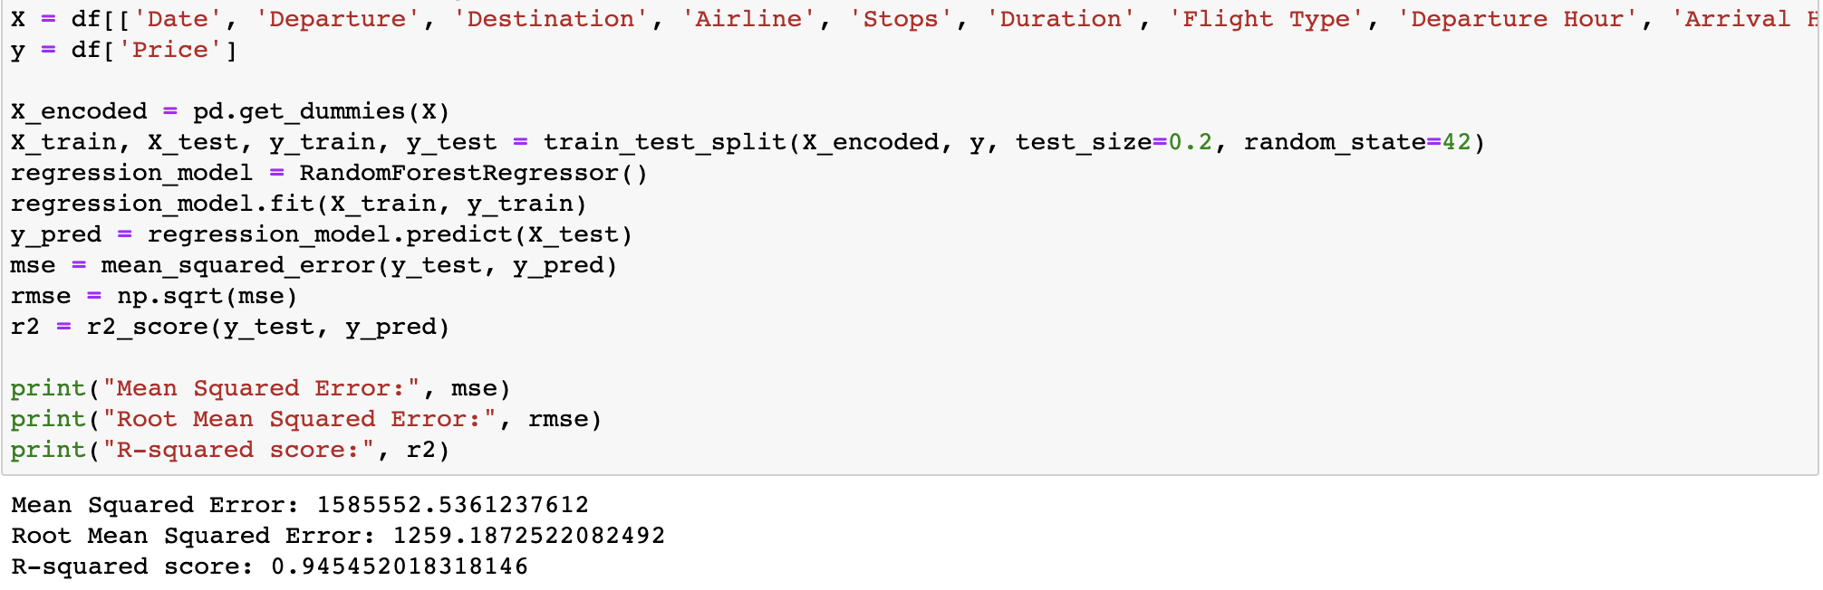
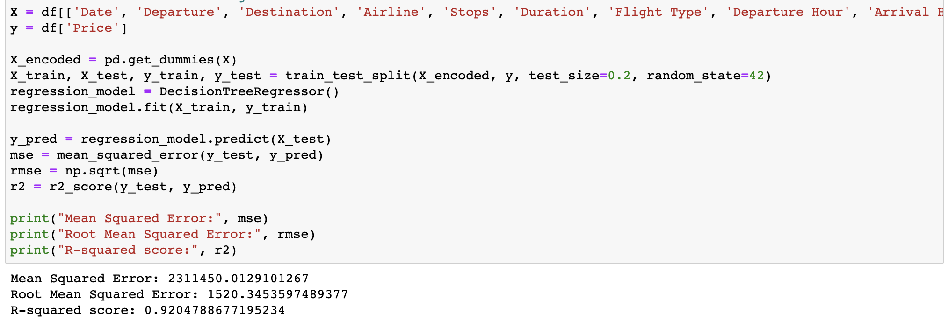
After the Linear Regression, I used other models to check if I can get better results.
I checked Decision Tree and Random Forest models.
The MSE of Decision Tree is lower than the Linear Regression and the R-squared score is higher with 92%.
The Random Forest model’s MSE is much lower than both Linear Regression and Decision Tree.
MSE measures the average squared difference between the predicted values and the actual values of the dependent variable. A lower MSE indicates that the model's predictions are closer to the actual values.
The R-squared score in the Random Forest Model is higher than both of Linear Regression and Decision Tree with 94.5%
the Random Forest model is considered better for predicting flight prices compared to the Decision Tree model. It achieves lower errors and a higher R-squared score, indicating improved predictive performance
Random Forest
Decision Tree
This Photo by Unknown Author is licensed under CC BY-SA

Slide 23
Conclusions

Slide 24

This topic is very interests me,
I love to make comparisons in flight prices when me or my family wants to fly.
According to the data collected and the Machine Learning results, it seems like the model shows promising results in predicting flight prices.
This Photo by Unknown Author is licensed under CC BY-SA

